Slide 1
COMP 1531
Tutorial 8

Slide 2
Today’s Agenda:
Software Engineering Design Principles
Domain modelling
(I forgot the chocolate, but I will be remembering who answers questions and bringing it for them next week)

Slide 3
Domain Modelling:
Given this description of a system for classified ads, answer the questions below:
Sellers advertise items for sale in one or more categories.
Buyers place enquiries about advertisements that sellers can respond to.
Each item for sale has an associated price, description, and phone number.
Buyers subscribe to categories they are interested in.
After receiving a response to their enquiry, buyers can accept that response to indicate they are satisfied with it.
Sellers can change the categories an item belongs to after the ad has been made.
Extract the nouns from the description above and decide which of those form entities in the ubiquitous language of the domain.
Draw a domain model as a UML class diagram, carefully considering the relationships between the classes.
Considering the verbs in the description and the behaviours they imply, write an implementation in python that corresponds to the model.

Slide 4
Extracting Nouns:
Nouns: `Seller`, `Category`, `Buyer`, `Enquiry`, `Response`
All of these are nouns with specific meaning in the above domain, so would be entities in that domain.
`Item`, `Advertisement` are used interchangeably in the description, suggesting that in this domain they are synonymous. Only one should be kept in the domain model.
`Price`, `Description`, `Phone number` are nouns in the description, they have no meaning in the domain beyond that which is commonly understood. Therefore, they are not entities in the domain model.

Slide 5
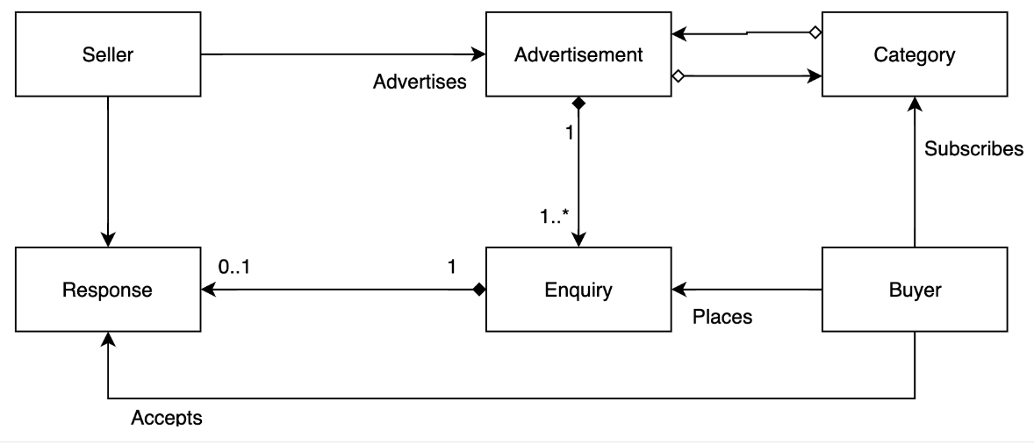
2. Constructing the Domain Model:

Slide 6
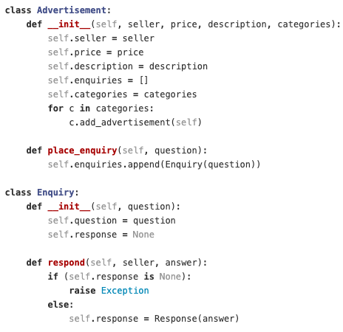
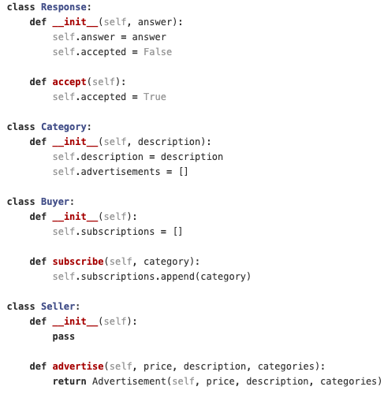
3. Python Implementation of the Behaviours Implied by The Verbs

Slide 7
The Difficulties of Group Work:
Q. How would you deal with the following situations appearing in a group?
Team member produces work that they weren’t meant to
Sit down and talk about how a miss-communication may have happened that caused them to produce something they weren't meant to
Team member not replying / not doing any work
Reach out to them in writing, make clear your issues, ask them for an action by a certain time
Team member replying, seeming engaged, but when push comes to shove not producing anything
Reach out to them in writing, make clear your issues, explain that you'll have to reduce their tasks if it continues
Most of your team not doing any work
Reach out to your tutor
You're feeling anxious about a team-work situation
Email your tutor

Slide 8
Single Responsibility Principle & Cohesion:
SRP: every module (class) in a program should have responsibility for only one chunk of functionality. Further, the elements of that responsibility should be encapsulated by the responsible class rather than spread out in unrelated classes.
This doesn’t mean one computation/line of code, it means all the computation necessary for one piece of functionality

Slide 9
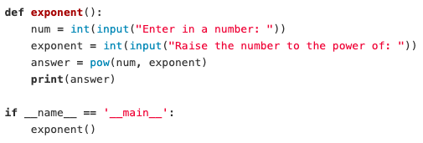
So What’s Wrong With This? How Would We Fix It?

Slide 10
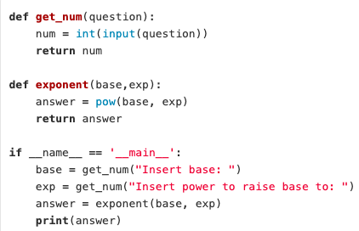
Separate Getting Input From Doing Exponentials:
Why this is better:
We can now get numbers for any other functions we might need in the future, since it is no longer contained in only a exponent context (maintenance and extension becomes much easier)
It’s more readable

Slide 11
Decorators:
Definition: a function that takes in another function
Used commonly to abstract repeated behaviour
I.e. IN YOUR PROJECTS, YOU SHOULD USE THEM TO VALIDATE LOGIN CREDENTIALS INSTEAD OF REPEATED THAT CODE EVERYWHERE, JUST CALL THE DECORATOR EACH TIME
@decoratorName
def function():
When you hit this function, python recognises that it’s ‘wrapped’ up in another function
You can then extend the functionality

Slide 12
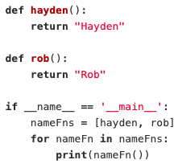
Write a very simple decorator that you can use on functions that return strings. This decorator will be called "greeting" and will add "Hello, " to the beginning of the string the function it decorates returns.

Slide 13
def greeting(function):
def wrapper(): <-define the function wrapper
return "Hello, " + function()
return wrapper <- call it to get the result
@greeting
def hayden():
return "Hayden"
@greeting
def rob():
return "Rob"
if __name__ == '__main__':
nameFns = [hayden, rob]
for nameFn in nameFns:
print(nameFn())
We need the greeting function to take in the original functions, and prepend the string hello to the return values of them.
return “Hello, ” + the return of argument function

